Slide 1

Forecasting
Unemployment Rate
OPIM-5671
Data Mining and Business Intelligence
GROUP 4
Abhinav Dubey
Jiaxuan Wang
Marina Suberlyak
Shaista Usman

Slide 2

Table Of Contents
Problem Statement
Goal
Data Description
Methodology:
Sample
Explore
Modify
Model & Results
Assess
Conclusions
Recommendations

Slide 3

Background
Unemployment rate is a proportion calculated by
number of unemployed persons
total number of persons in the labour force
People are classified as unemployed if they fulfill the following three criteria:
Do not have a job
Have actively looked for work in the prior four weeks
Are currently available for work

Slide 4

Problem Statement
Unemployment rate allows policy makers to examine health of the labor market and the economy. Understanding and forecasting patterns in unemployment are key to:
inform government unemployment insurance budgets and incentives
devise fiscal policies to remedy the causes of unemployment, particularly during economic downturns
identify when governments should increase asset purchases and investments
Notes:
Why study and forecast unemployment?
inform UI budgets
restrospectively, understand movements in the labor market relative to external events and devise incentives and policies to correct the causes of unemployment. This is especially important during downturns when the labor market participants rely on government intervention provide a safety net, stabilize the economy and devise incentives for the markets to bounce back
define when and how government can increase asset investments
Why are WE interested in unemployment rate? 1. interesting, unintuitive time series. 2. full of events and externalities. 3. it’s personal - health of the labor market will inevitably influence our lives

Slide 5

Goal
We will model historical unemployment rate using available time series for unemployment in the United States.
The analysis will seek to model trend, seasonality, irregularity and any useful events from the historical unemployment rate, plus explore any regressors, and then forecast near-term unemployment rate to inform policymakers in devising government and economic response.

Slide 6

Data Description - sources
The Official U.S. unemployment statistics ¹ are produced by the U.S. Bureau of Labor Statistics, and released on the first Friday of every month
Additional time series considered:
Job Openings and Labor Turnover Survey ²
Initial Claims for Unemployment Insurance ³
Dow Jones Industrial average ⁴ as measure of stock market performance
Consumer Price Index ⁵ as measure of inflation
¹ Federal Reserve Economic Data | FRED | St. Louis Fed | ⁴ Stooq, historical stock market data available for download
² Job Openings, ³ Initial Claims | ⁵ US Inflation Calculator
Notes:
observation_date: Date of observation of the current rate of unemployment, calculated monthly.
UNRATE: Labor force data are restricted to people 16 years of age and older, who currently reside in 1 of the 50 states or the District of Columbia, who do not reside in institutions (e.g., penal and mental facilities, homes for the aged), and who are not on active duty in the Armed Forces.
An initial claim is a claim filed by an unemployed individual after a separation from an employer.
Job openings are seasonally adjusted and aggregated across industries, compiled via a survey

Slide 7

Data Description - data elements
Observation date, monthly
Unemployment rate, as percentage of total labour force, monthly
ICSA, as absolute jobless claims per month
Job openings, as absolute job openings per month
DJI, as close level on last day of month
CPI, as average price of a basket of goods indexed against same basket price of 1982-84
Notes:
observation_date: Date of observation of the current rate of unemployment, calculated monthly.
UNRATE: Labor force data are restricted to people 16 years of age and older, who currently reside in 1 of the 50 states or the District of Columbia, who do not reside in institutions (e.g., penal and mental facilities, homes for the aged), and who are not on active duty in the Armed Forces.
An initial claim is a claim filed by an unemployed individual after a separation from an employer.
Job openings are seasonally adjusted and aggregated across industries, compiled via a survey

Slide 8
Methodology
Sample the time series
visual inspection & research
Explore and diagnose
interventions, stationary analysis
Modify
define time periods to model, holdout and any missing values
Model and examine the results
attempt multiple approaches
Assess and conclude
compare models and discuss recommendations

Slide 9
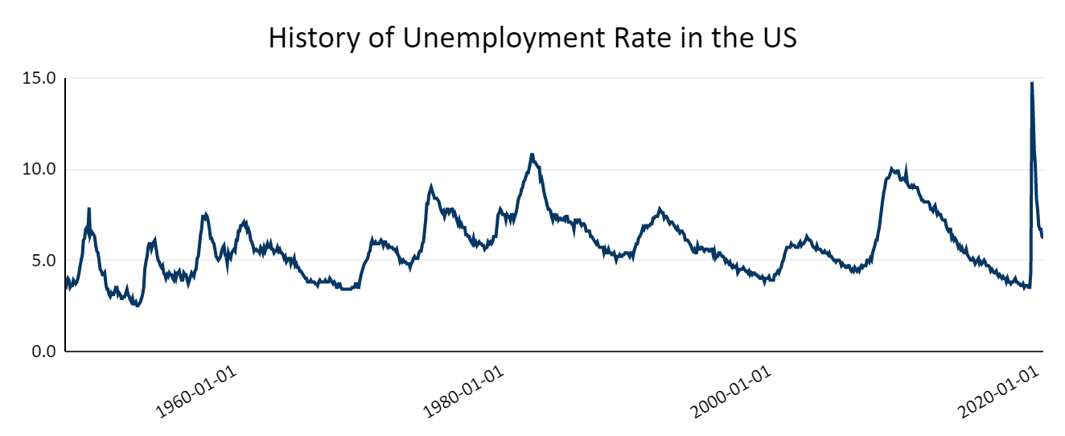
Sample - many events, or none
Recessions of post WWII, Korean War, interest rate spike
Oil Embargo,
Energy Crisis of 1980s
Gulf War
Great Recession
COVID
Notes:
Healthy unemployment rate is accepted in the range of 4-5%
Because there are so many spikes and dips, supported by historical events, one of the approaches we had to consider is not capturing any events at all and treating all events as irregularity

Slide 10
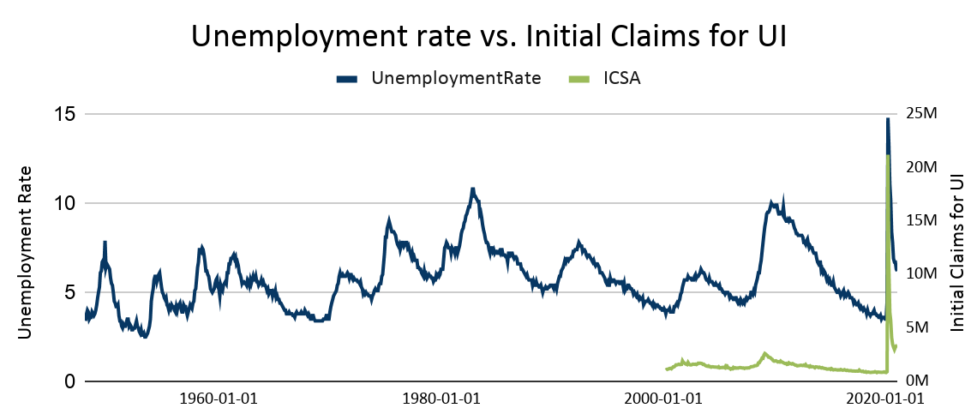
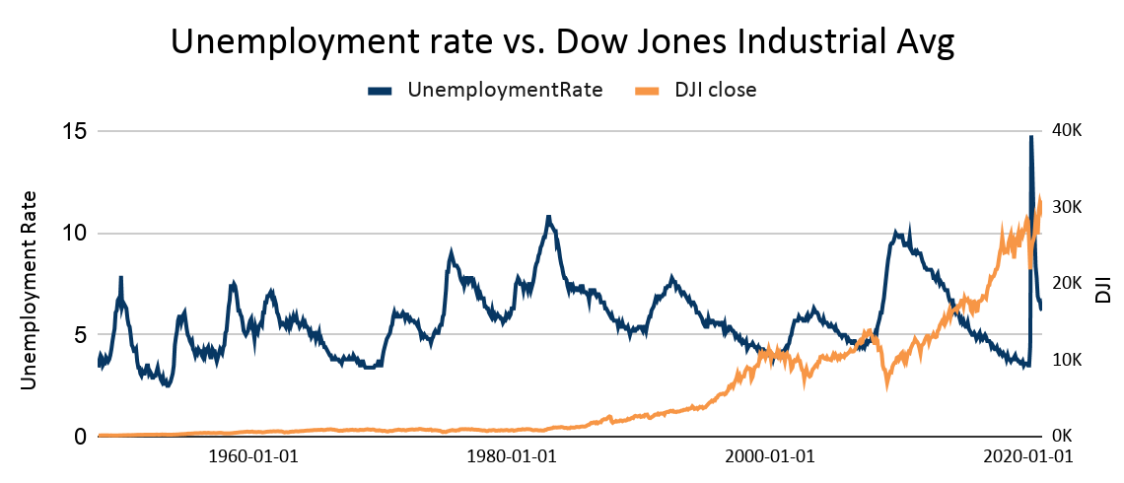
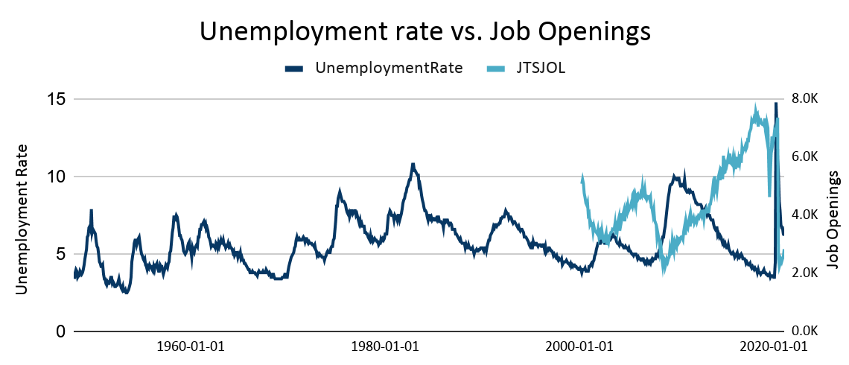
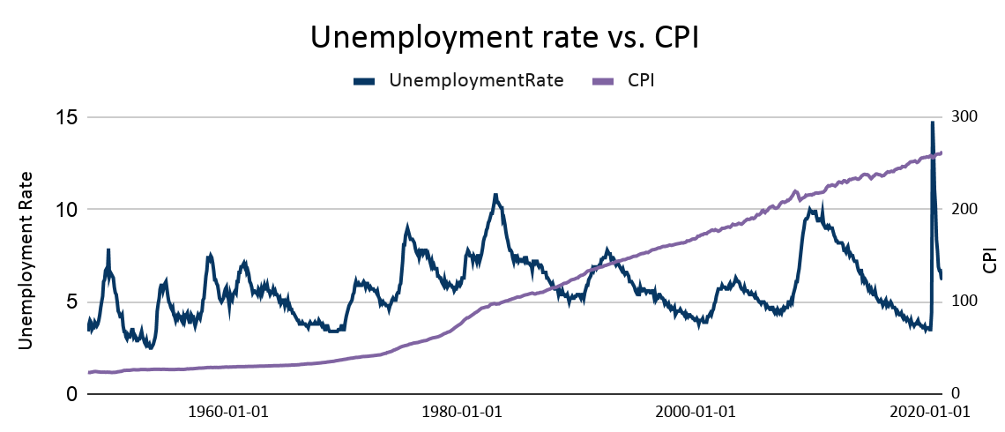
Explore - regressors
Notes:
DJI and CPI regressors have a very different shape vs. unemployment as they represent a relative score rather than an absolute number; in future analysis we may explore indexing these against some average but for this exercise, we chose to exclude these variables from regressors
Some regressors don’t provide full data horizon and we address that during Modify step of the methodology

Slide 11
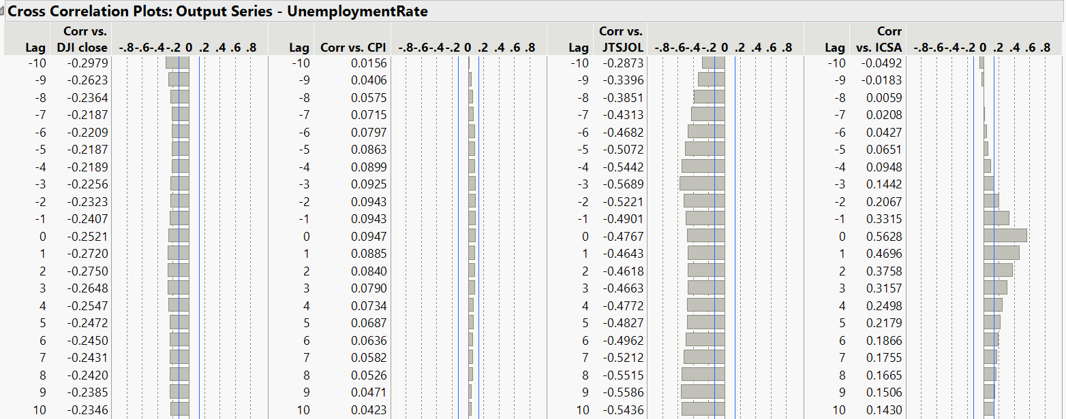
Explore - cross correlation
will attempt Job Openings and Initial Claims as standard regressors; DJI showed no significance during analysis
Notes:
Cross correlation shows Job Opening and Initial Claims are the more promising regressors; however, since the data horizon is much shorter here, we decided to split our analysis into 2:
model unemployment rate across entire time series, 1948+ and consider events only
model unemployment rate with most promising regressors, 2000+
we then evaluate both for performance and suggest the better approach

Slide 12
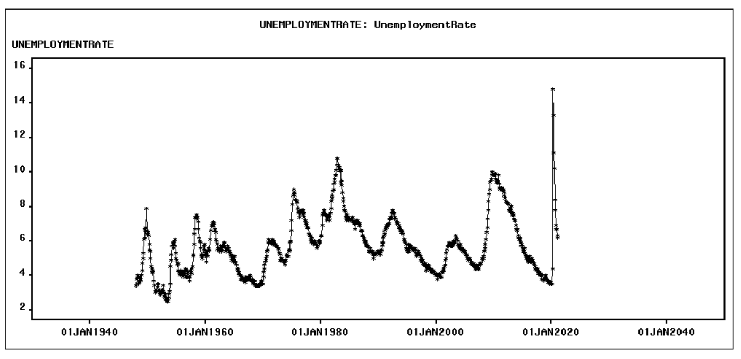
Model 1 - with events
Timeline:
January 1948
to
February 2021
Notes:
We have done modeling on this data in two sections. In the first section, we have modeled Trends, Events, and Irregularity. In the second section, we have modeled Regressors, Trend, and Irregularity.
I will present the first section—model 1 with events. The timeline for model 1 is from January 1948 to February 2021.

Slide 13
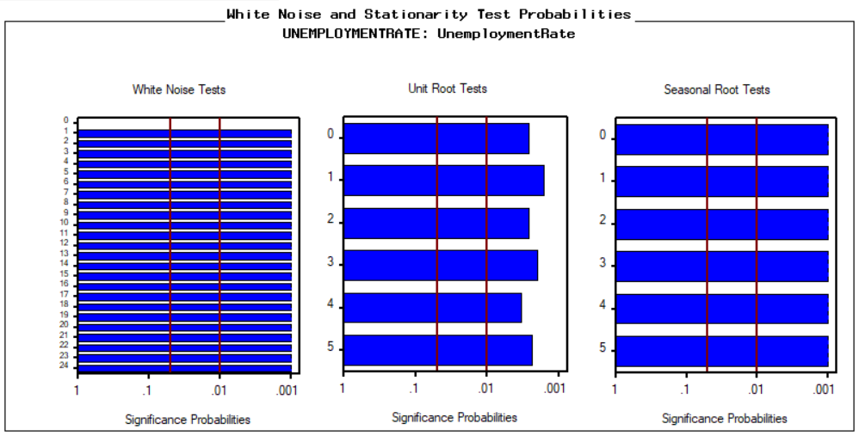
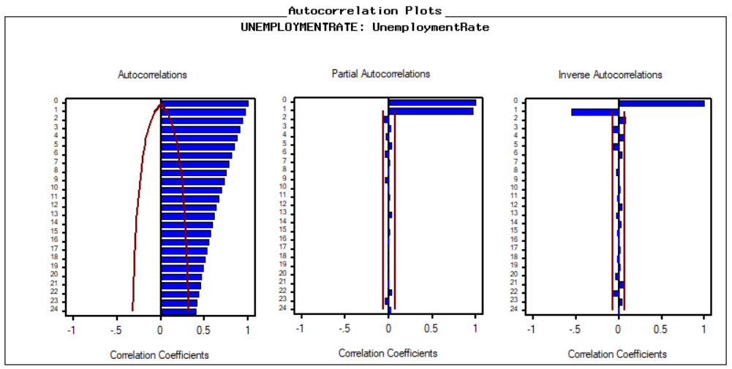
Stationary or Non-Stationary
The Autocorrelation Plots, White Noise tests and Unit Root tests indicate:
Presence of Trend.
Absence of Seasonality.
The series is not White Noise.
Therefore, the Time Series is Non-Stationary.
Notes:
Examining the autocorrelation plots, we observe decaying significance post lag 1 in ACF, and no repetitive behavior over S time units in PACF and IACF. Unit Root test shows significance, denying presence of trend. We remain conscious that we have multiple events, which may be breaking the trend. We conclude the series is non-stationary, with possible trend, irregularity and no seasonality .

Slide 14
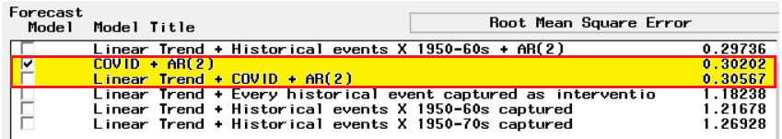
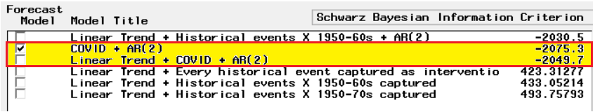
Modeling Trend, Events and Irregularity
We modelled all the events from 1948 to 2020 and trend without including regressors. The best two models with all parameters significant and in limits are
Linear Trend + COVID + AR(2)
COVID + AR(2)
Notes:
As Jiaxuan mentioned before in our time series data we have many events or peaks in which the unemployment rate increased in the timeline from 1948 to 2021.
In this slide you can see different models which we tried fitting several models with different trend curves, events and tried all possible combinations of p and q for modeling the stationary component.
We narrowed down to two models which are COVID + AR(2) and Linear Trend + COVID + AR(2).

Slide 15
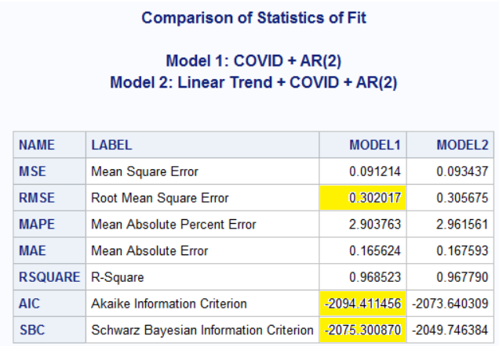
Model Evaluation
Conclusion: COVID + AR(2) is the best model based on RMSE, AIC and SBC.
Notes:
The model with COVID + AR(2) had all significant parameters and a lower RMSE , AIC and SBC when compared to all other models.

Slide 16
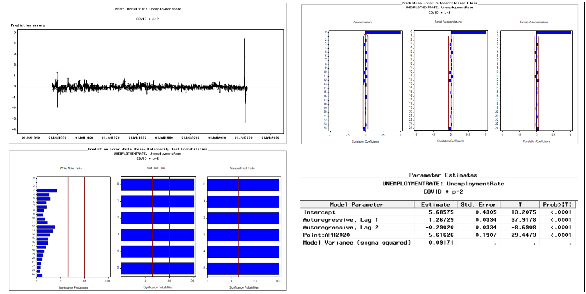
Model Evaluation (Cont'd)
Reasoning: model achieves random residuals, clean Autocorrelation plots and White Noise. All parameters are significant.
Notes:
COVID + AR(2)
The model passes the white noise test.
The ACF, PACF, AICF plots do not have any significant lags.
The residual plot further has random peaks indicating the time series is close to being white noise.
Thus, Residual plot, Autocorrelation plots, White Noise and Root Tests indicate that trend and irregularity has been modelled successfully.

Slide 17
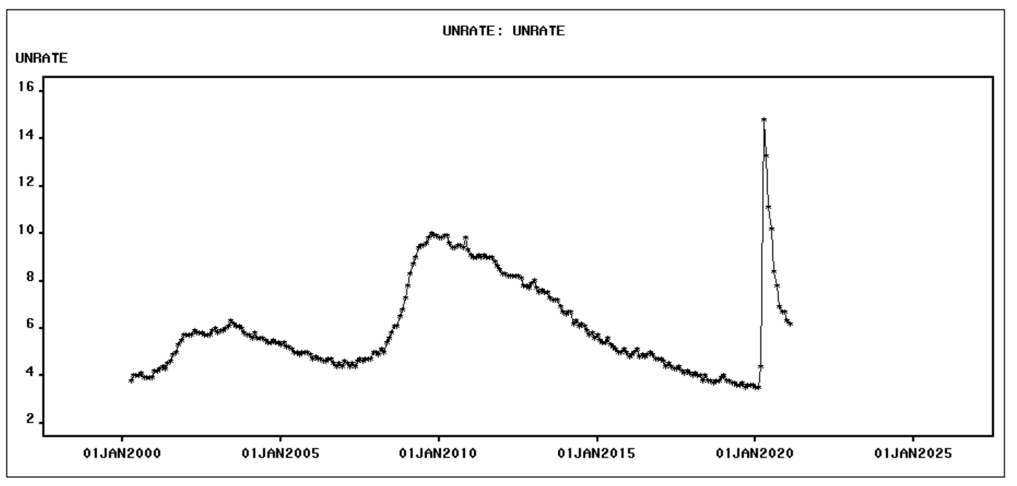
Model 2 - with Regressors
Timeline:
April 2000 to Feb 2021

Slide 18
Modify
The historical data on the Time series was pruned, to align it with the data for Regressors that were available from 2000 onwards.
The weekly data for Initial Claims for Unemployment Insurance (ICSA) was aggregated over a period of 4 weeks (in the same way as UNRATE data is collected) to align it with the available monthly UNRATE data.

Slide 19
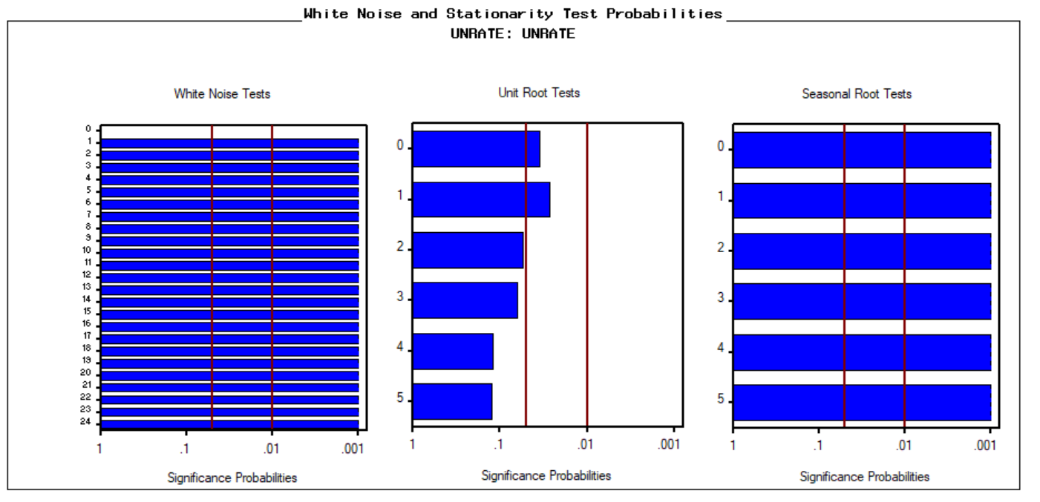
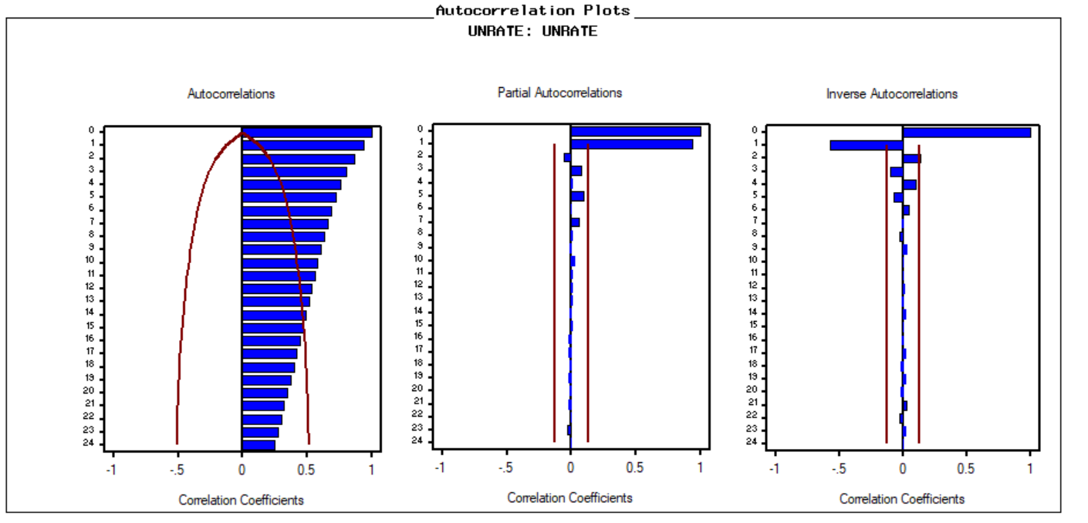
Stationary or Non-Stationary
The Autocorrelation Plots, White Noise tests and Unit Root tests indicate:
Presence of Trend.
Absence of Seasonality.
The series is not White Noise.
Therefore, the Time Series is Non-Stationary.
Notes:
Trend : The ACF plot has several significant lags decaying slowly post lag 0, which become insignificant on applying first differencing, indicating the presence of a trend. The PACF and IACF are highly significant at lag 1.
Unit root test lags are insignificant which become significant on applying difference of the first order, indicating the presence of a trend.
Seasonality: There is no Seasonality as the time series does not have significant ACF, PACF, and IACF values at lag S and does not exhibit any repetitive behavior over S time units.
The seasonal root tests further have significant lags confirming for the absence of seasonality.
Seasonal unit root tests remain significant on applying difference of order S.
The series is not white noise since there are significant lags in the white noise test. Thus, we reject the null hypothesis.
Since the Time Series has some trend, it is Non-Stationary.

Slide 20
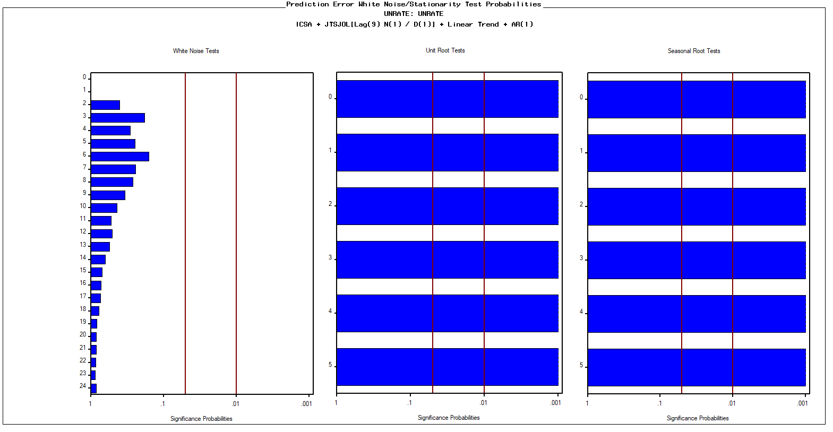
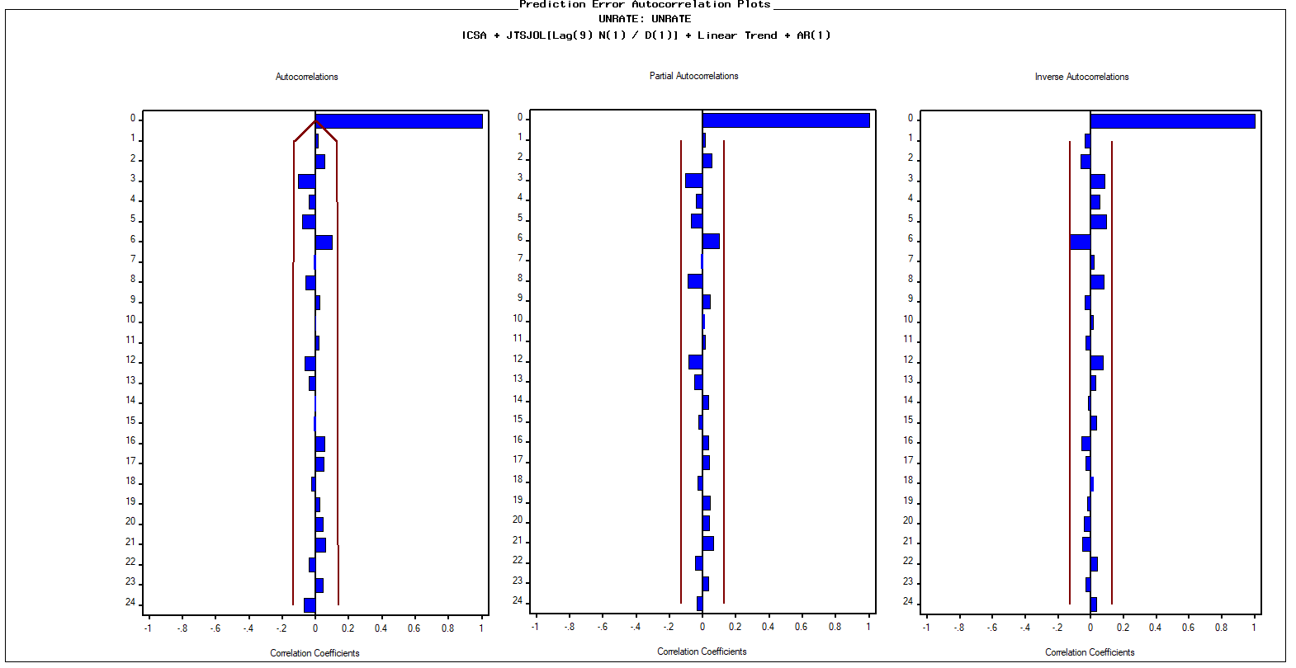
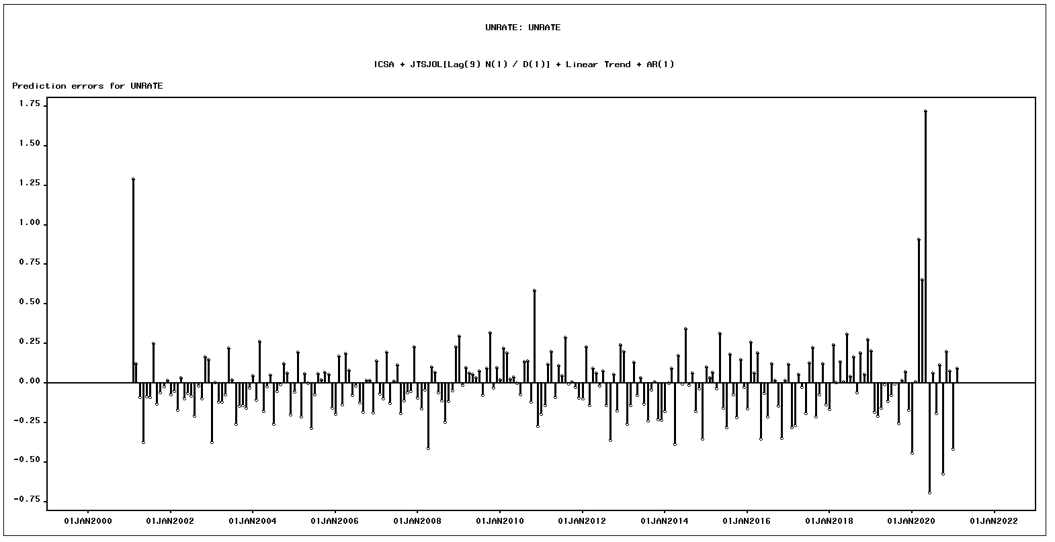
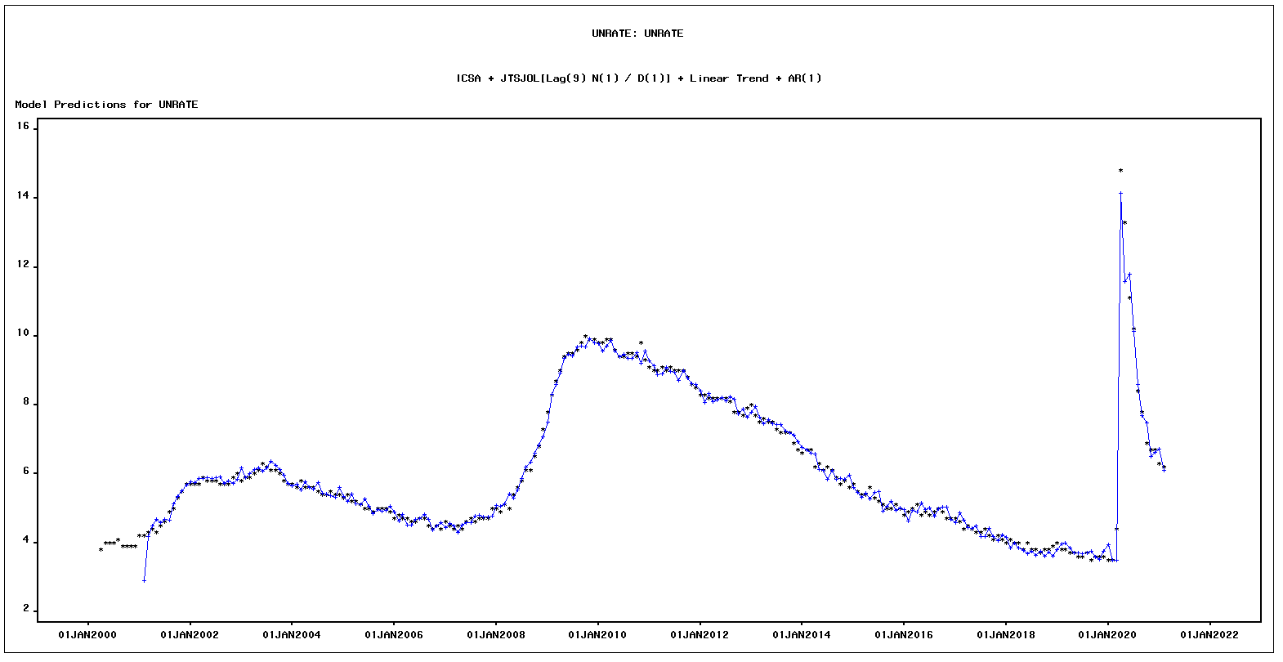
Modeling Regressors, Trend and Irregularity
Model includes:
Regressors: Initial Claims for Unemployment Insurance (ICSA) and Job Openings and Labor Turnover (JTSJOL)
Trend
Irregularity via autoregressive model
Notes:
The model passes the white noise test, unit root test (highly insignificant lags) and seasonal root test (all lags are significant).
The ACF, PACF, AICF plots do not have any significant lags.
The residual plot further has random peaks indicating the time series is close to being white noise.
Thus, Residual plot, Autocorrelation plots, White Noise and Root Tests indicate that trend and irregularity has been modelled successfully.

Slide 21
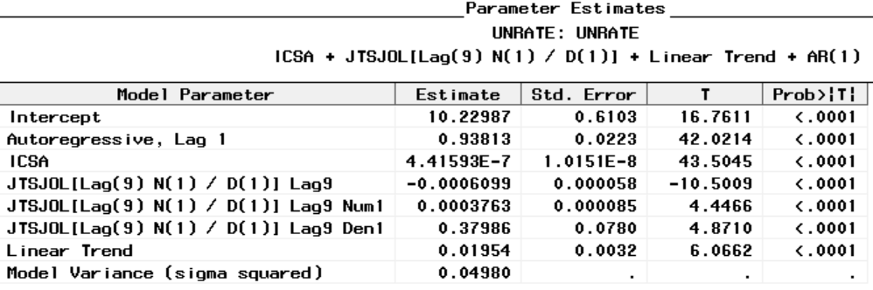
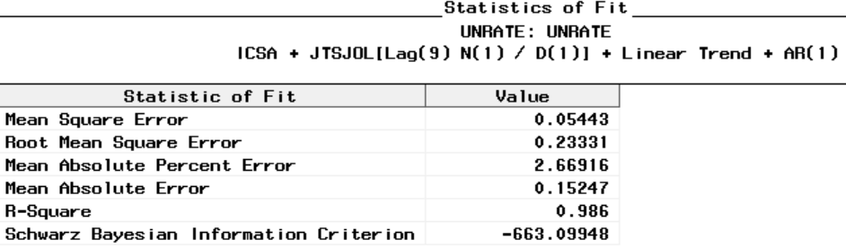
Model Evaluation
The model has all significant parameters and a low RMSE and SBC.
The model captures enough variance from the data while still being less complex and not overfitting the data.
Notes:
We tried fitting several models with different trend curves and further tried all possible combinations of p and q for modeling the stationary component.
The model with linear trend and AR(1) (and dynamic regressor for JTSJOL and regular regressor for ICSA) had all significant parameters and a lower RMSE and SBC compared to all other models.

Slide 22

Assess
We will evaluate our 2 models on:
RMSE
SBC & AIC
Complexity
Forecast reasonableness
Inclusion of data available

Slide 23

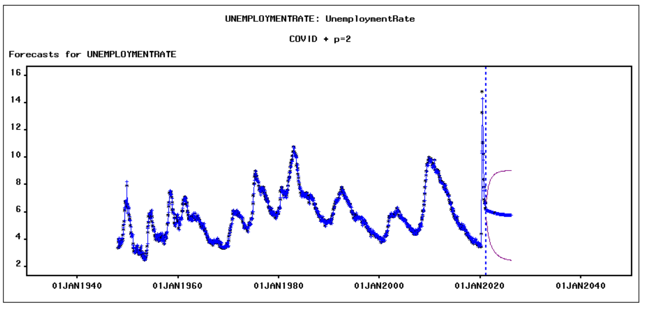
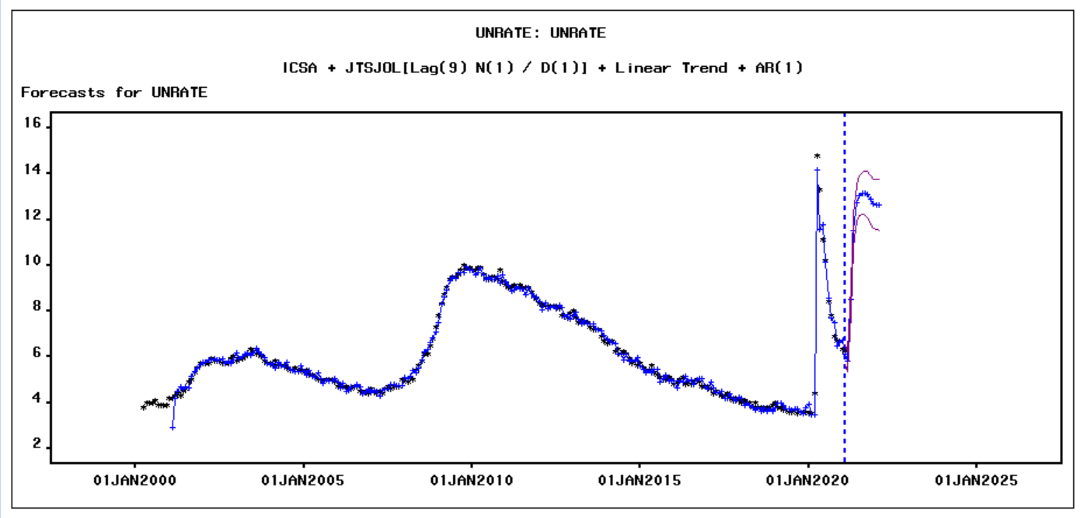
Results
MODEL 1
MODEL 2
RMSE: 0.3020
SBC: -2075.3
AIC: -2094.41
Forecast: believable
Period: more comprehensive
RMSE: 0.2333
SBC: -663.1
AIC: -687.5
Forecast: unreasonable
Period: only recent decades
Notes:
By comparing model one and model two, we decided model one is our best model, which is AR2 with covid event. although the error is a little bit higher, it is less complex and has a lower AIC. And If you look at the forecast plot, you can see that compared to Model 2, Model 1 forecast of the unemployment rate in the next five years is more reasonable. Besides that, the timeline for model 1 is more comprehensive, it covers the data from 1948 to 2021.

Slide 24
Recommendations
Improve accuracy:
Add interventions appropriately
Regressors worthwhile to explore if more historical data is available
Validate against domain expert knowledge and intuition, e.g. post COVID forecast
Improve labor market:
Change fiscal policy and develop an expansionary monetary policy
Provide education and training to the labor force
Notes:
1. Add interventions appropriately. It is very important to add appropriate events to improve the accuracy of the forecast. Although through the time series plot, we believe that there may be many events that have caused the unemployment rate to rise, trying to include all events does not help the model to get a better performance.
2. Regressors worthwhile to explore if more historical data is available. As we noticed earlier, by adding regressors, the error of the model decreased. Regressors can help us to improve model performance, but we need to make sure that we have sufficient data
3. Validate model forecast against domain expert knowledge and intuition.you might think that the unemployment rate has cycles When you first look at the graph, but after our diagnosis, the data has no seasonality.

Slide 25
Conclusion
Lastly, it is critical to model unemployment rate in the context of:
Other economic factors, especially leading indicators for unemployment
Ample, complete data for additional variables
Notes:
To help policymaker and governments formulate more effective policies, we believe that in addition to the trend, seasonality and critical events, Other economic factors, especially leading indicators for unemployment and the complete data for additional variables are keys to forecasting employment rate.

